Slide 1
Workflow Optimization
Optimal Job Assignment in a Discrete Event Simulation Environment
Filip Kočovski

Slide 2
Table of Contents

Slide 3

Table of Contents
Introduction
Motivation
Research Questions
Methodology
Discrete Event Simulation
Mixed Integer Linear Programming Policies
Reinforcement Learning Policies
Results
Mixed Integer Linear Programming
Reinforcement Learning
Discussion, Conclusion and Outlook

Slide 4
Introduction

Slide 5
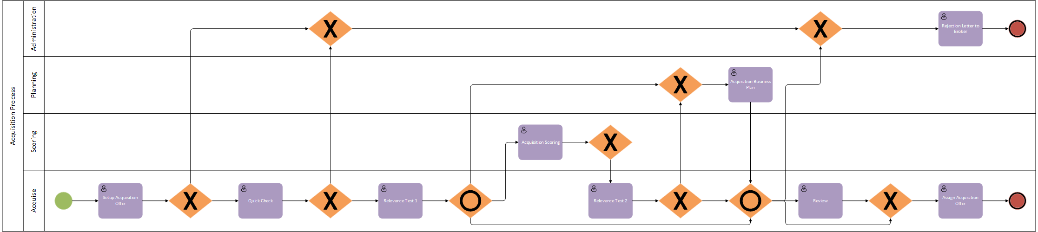
Motivation
Optimize human agents interaction with workflow management systems in order to:
Save costs
Equalize workload fairness
Improve resources usage
Further develop traditional role resolution methods
Solve role resolution in a stochastic fashion
Pull vs push based optimization potential

Slide 6

Research Questions
Do traditional mixed integer linear programming based methods for role resolution in workflow management systems exhibit further optimization potential?
Do cutting edge alternative approaches for role resolution in workflow management systems exist?

Slide 7
Methodology

Slide 8


Key Performance Indicators (KPIs)
Maximum Flowtime = Lateness: $L_{j}=F−A$
Wait Time: $w_{j}=S−A$
Service Time: $p_{ij}=F−S$
Average System Load: $\overline{l}=\frac{\sum_{i}{l_{i}}}{n}$

Slide 9
Discrete Event Simulation Environment
Policy based role resolution

Slide 10

Optimization Policies According to Zeng and Zhao (2005)
Greedy
Least Loaded Qualified Person (LLQP)
Shared Queue (SQ)
K-Batch
K-Batch-1
1-Batch-1
Optimization

Slide 11

Least Loaded Qualified Person (LLQP)

Slide 12

K-Batch

Slide 13
Mixed Integer Linear Programming Policies
Minimizing Sequential Assignment (MSA)
Dynamic Minimization of Maximum Task Flowtime (DMF)
Simplified DMF (SDMF)
Extremely Simplified DMF (ESDMF)
Service Time Minimization with ESDMF as Upper Bound (ST)

Slide 14









Minimizing Sequential Assignment (MSA)
$$\min_{}{z}$$
$$\text{subject} \text{to}$$
$$\sum_{i}{x_{ij}=1}$$
$$a_{i}+\sum_{j}{x_{ij}p_{ij}≤z}$$
$$x_{ij}=0 \text{or} x_{ij}=1$$
$$z$$
$$a_{1}$$
$$p_{11}$$
$$p_{12}$$
$$a_{2}$$
$$p_{23}$$
task flowtime
$$z_{1}$$
$$z_{2}$$

Slide 15
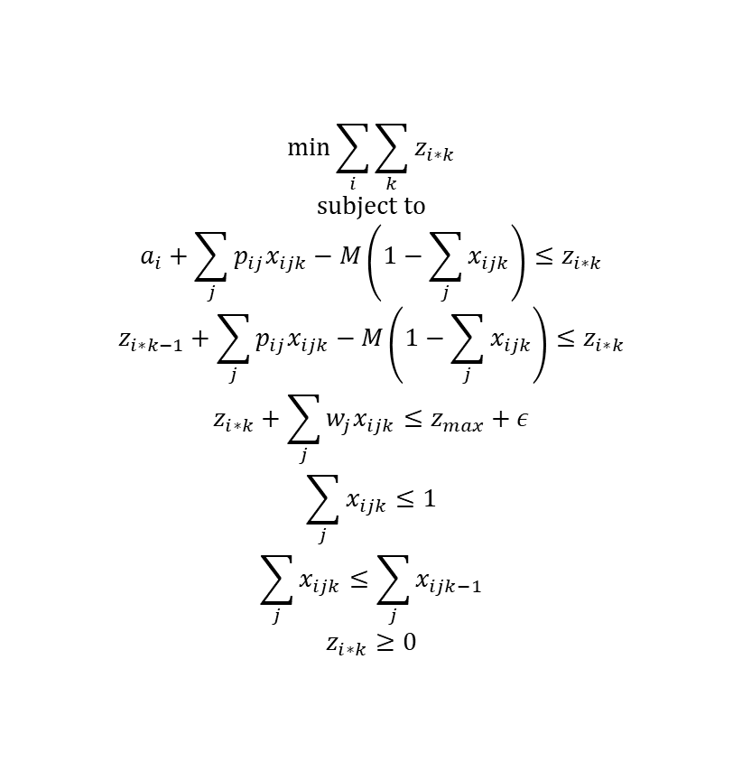
Service Time Minimization with ESDMF as Upper Bound (ST)
$$\min_{}{\sum_{i}{\sum_{k}{z_{i∗k}}}}$$
$$\text{subject} \text{to}$$
$$a_{i}+\sum_{j}{p_{ij}x_{ijk}−M\left(1−\sum_{j}{x_{ijk}}\right)≤z_{i∗k}}$$
$$z_{i∗k−1}+\sum_{j}{p_{ij}x_{ijk}−M\left(1−\sum_{j}{x_{ijk}}\right)≤z_{i∗k}}$$
$$z_{i∗k}+\sum_{j}{w_{j}x_{ijk}≤z_{max}+ε}$$
$$\sum_{j}{x_{ijk}≤1}$$
$$\sum_{j}{x_{ijk}≤\sum_{j}{x_{ijk−1}}}$$
$$z_{i∗k}≥0$$
$$z$$
$$a_{1}$$
$$p_{11}$$
$$p_{12}$$
$$a_{2}$$
$$p_{23}$$
task flowtime
$$z_{1}$$
$$z_{2}$$

Slide 16
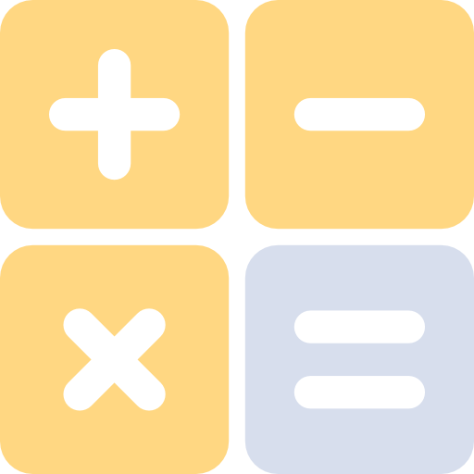
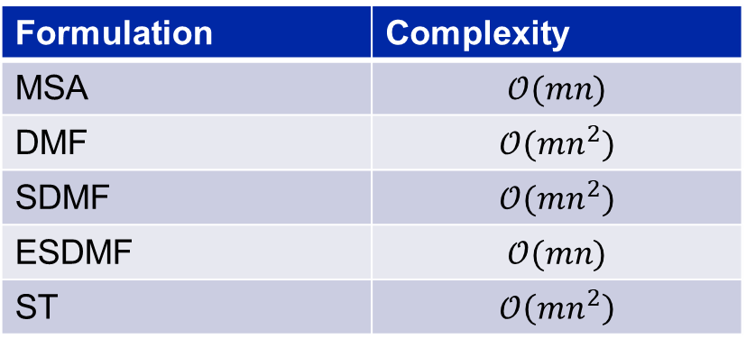
Formulation Complexity
Formulation | Complexity
MSA | $$𝒪(mn)$$
DMF | $$𝒪(mn^{2})$$
SDMF | $$𝒪(mn^{2})$$
ESDMF | $$𝒪(mn)$$
ST | $$𝒪\left(mn^{2}\right)$$
Notes:
m = number of users
n = batch size

Slide 17

Reinforcement Learning According to Sutton and Barto (2017)
Originates from machine learning
Agents interact with environment to learn
No training sets required
Key concepts:
States: current system conformation of busy times and service times
Actions: mapping of user to job
Rewards: lateness to be minimized

Slide 18
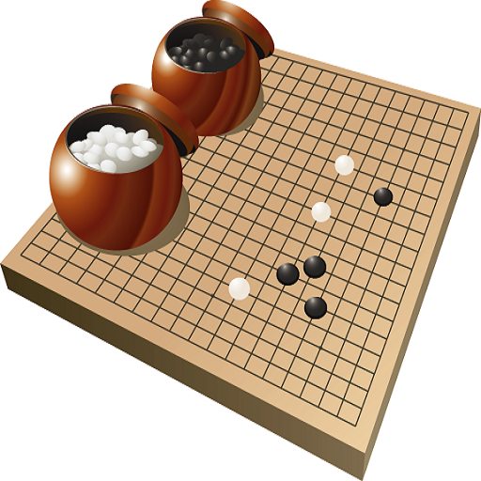

State Space Size
Backgammon: ${10}^{20}$ states
Go: ${10}^{170}$ states
Flying a helicopter: continuous state space
ST formulation for 100 users and 100 jobs: $2^{mn^{2}}≈{10}^{100000}$ states

Slide 19


Reinforcement Learning Policies
Policy: $q_{π}(s,a)$
Value Function Approximation (VFA)
Policy Gradient (PG)
Artificial Neural Networks (ANNs)

Slide 20


Value Function Approximation
Approximated values
$$\hat{q}\left(s,a,θ\right)≈q_{π}(s,a)$$
Maximize approximated values
$$q_{∗}\left(s,a\right)≐\max_{π}{\hat{q}(s,a,θ)}$$

Slide 21
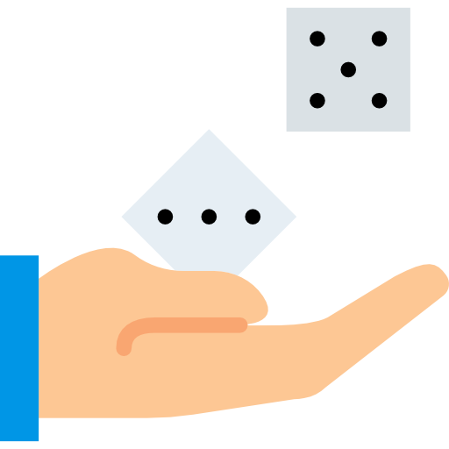
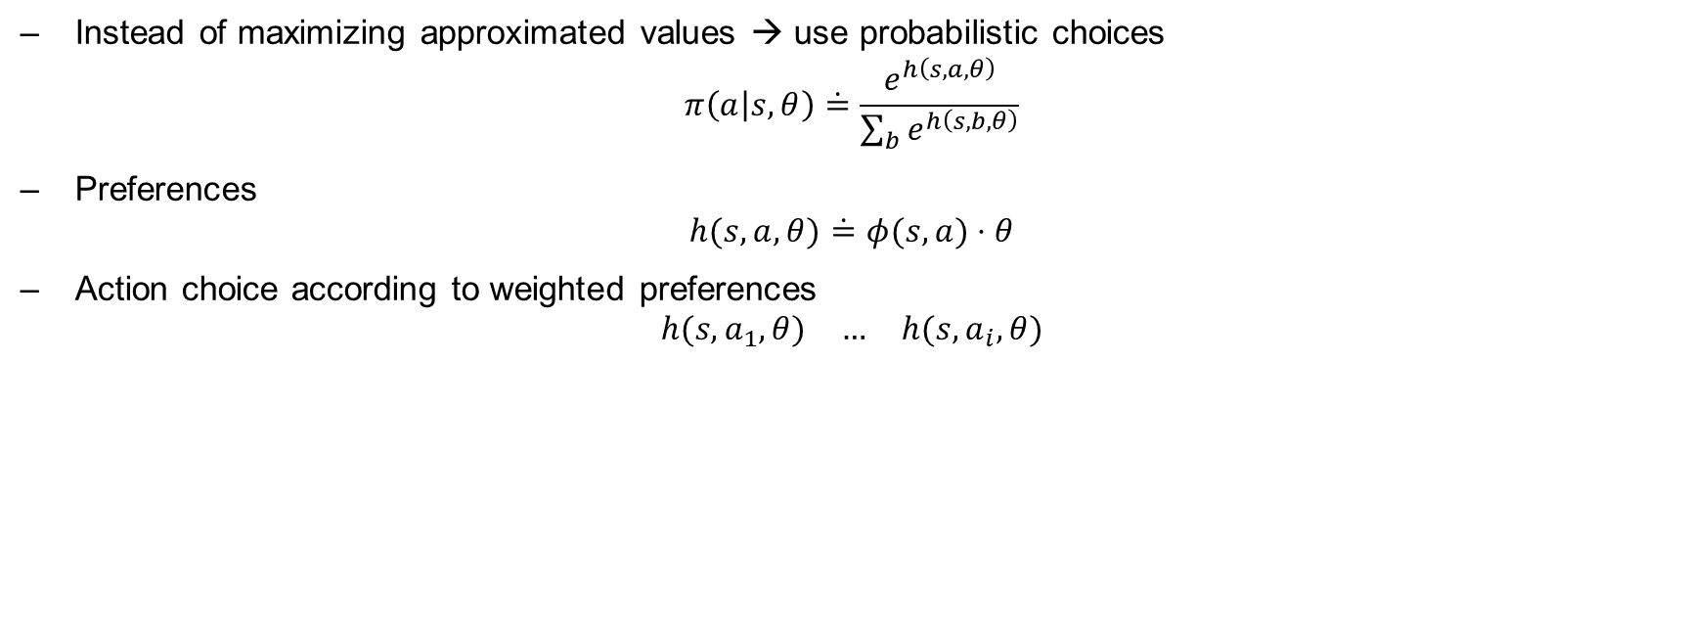
Policy Gradient
Instead of maximizing approximated values → use probabilistic choices
$$π\left(a | s,θ\right)\dot{=}\frac{e^{h\left(s,a,θ\right)}}{\sum_{b}{e^{h\left(s,b,θ\right)}}}$$
Preferences
$$h(s,a,θ)\dot{=}φ(s,a)⋅θ$$
Action choice according to weighted preferences
$$\begin{matrix}h(s,a_{1},θ) & … & h(s,a_{i},θ)\end{matrix}$$

Slide 22
Artificial Neural Networks
Nonlinear approximation
Use policy gradient approach for softmax categorization of output layer
Update synaptic connections by means of MC based backpropagation

Slide 23
Results

Slide 24
Global Parameters
Variable | Value
Number of Users | 5
Service Interval | 1
Generation Interval | 3
Simulation Time | 1000
Batch Size | 5 (1 for 1-Batch-1)
Task Variability | 20% of service interval
Worker Variability | 20% of service interval
Random State Seed | 2
Process | Acquisition

Slide 25
Mixed Integer Linear Programming Results
KPI | Speedup
Lateness | 1.23
Wait Time | 4.0
Service Time | 1.1
Average System Load | 1.1

Slide 26
Reinforcement Learning Results
KPI | Speedup
Lateness | 1.2
Wait Time | 2.33
Service Time | 1.1
Average System Load | 1.1

Slide 27
Discussion, Conclusion and Outlook

Slide 28
Optimization Fairness

Slide 29
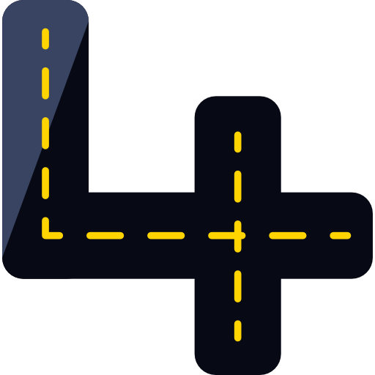
MILP Speedup Tradeoff
1.23-fold speedup requires quadratic higher complexity and twofold optimization
Solves role resolution in a deterministic way
Business tradeoff:
Higher formulation complexity requirement for marginal speedup
Better use less precise formulation with less formulation complexity requirements?

Slide 30

Reinforcement Learning Alternative
Similar improvements as ST without high formulation complexity
Solves role resolution in a stochastic way
To be accounted for:
Training sessions requirement for optimal convergence
Domain overfitting

Slide 31

Future Work
Test in operative environments
Recurrent Artificial Neural Networks
Inverse Reinforcement Learning
Apprenticeship Learning

Slide 32

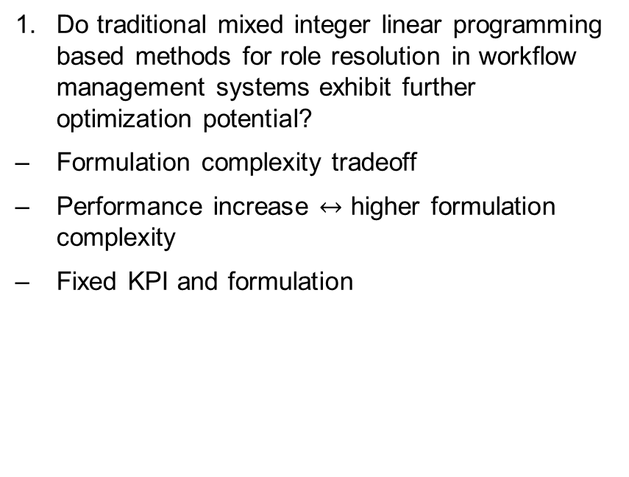
Research Question 1
Do traditional mixed integer linear programming based methods for role resolution in workflow management systems exhibit further optimization potential?
Formulation complexity tradeoff
Performance increase $↔$ higher formulation complexity
Fixed KPI and formulation

Slide 33
Research Question 2
Do cutting edge alternative approaches for role resolution in workflow management systems exist?
Long training sessions for reinforcement learning
Overfitting
Vanishing and exploding gradient problem for deep artificial neural networks

